Slide 1
Reading from graphs
Graphical representations

Slide 2
How our teaching resources are designed for the classroom

Slide 3
I can read and interpret points from a graph to solve problems.

Slide 4
The relationship between two variables is linear if, when plotted on a pair of axes, a straight line is formed.
A quadratic is an equation, graph, or sequence whereby the highest exponent of the variable is 2.
For example, x² + x is quadratic but x³ + x is not.

Slide 5
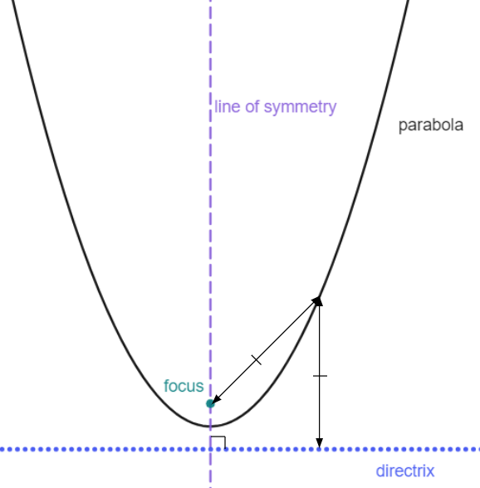
A parabola is a curve where any point on the curve is an equal distance from:
a fixed point (the focus ), and
a fixed straight line (the directrix )
The line of symmetry goes through the focus, at right angles to the directrix.

Slide 6

Reading from graphs
Reading from linear graphs
Reading from quadratic graphs

Slide 7
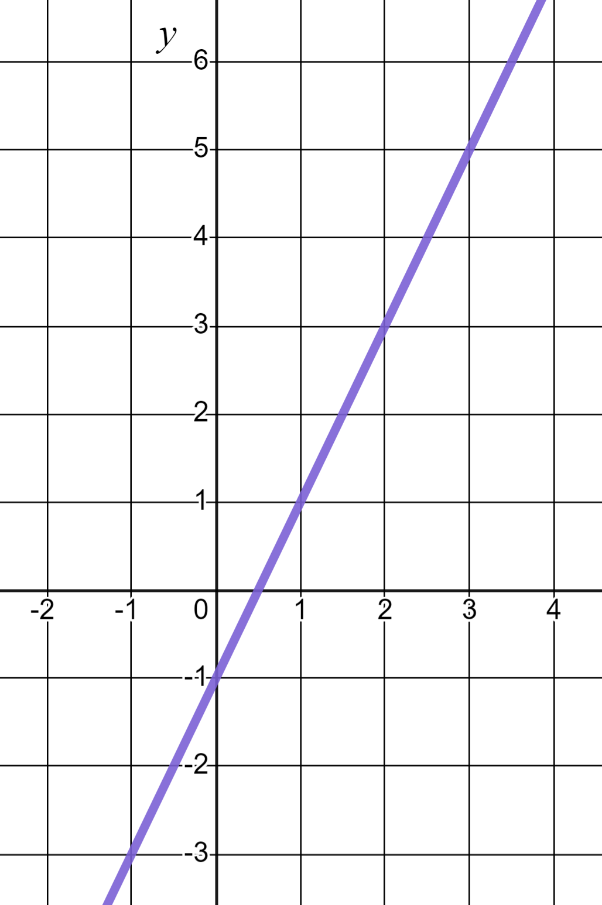

Reading from linear graphs
In mathematics we don’t just plot linear graphs.
We use them to solve problems by taking readings from them.
This is the graph of the linear equation y = 2x − 1 from which we can read the coordinate (3, 5)
This is the graph of the linear equation y = 2x − 1
✖
(3, 5)
This means that the values x = 3, y = 5 must fit the equation.
x
y = 2x − 1
(5) = 2(3) − 1

Slide 8
Reading from linear graphs
This coordinate reading also tells us something else.
It is the solution to the equation 2x − 1 = 5
✖
(3, 5)
When does the line y = 2x − 1 have a y-coordinate of 5?
When x = 3
x
x = 3 is the solution to the equation 2x − 1 = 5

Slide 9
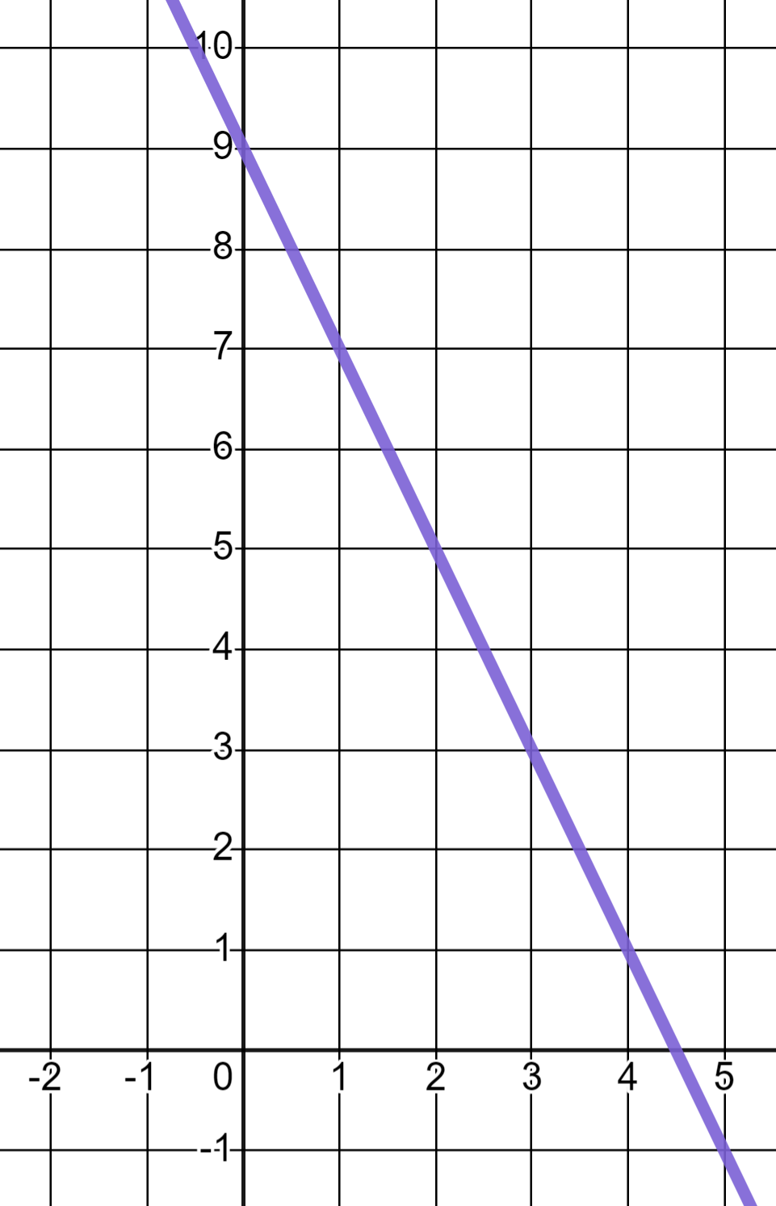
Reading from linear graphs
Reading from the graph which of these is the solution to the equation 9 − 2x = 1 ?
y = 9 − 2x
When does the line y = 9 − 2x have a y-value of 1?
When x = 4
x = 1
x = 7
x = 4
✖

Slide 10
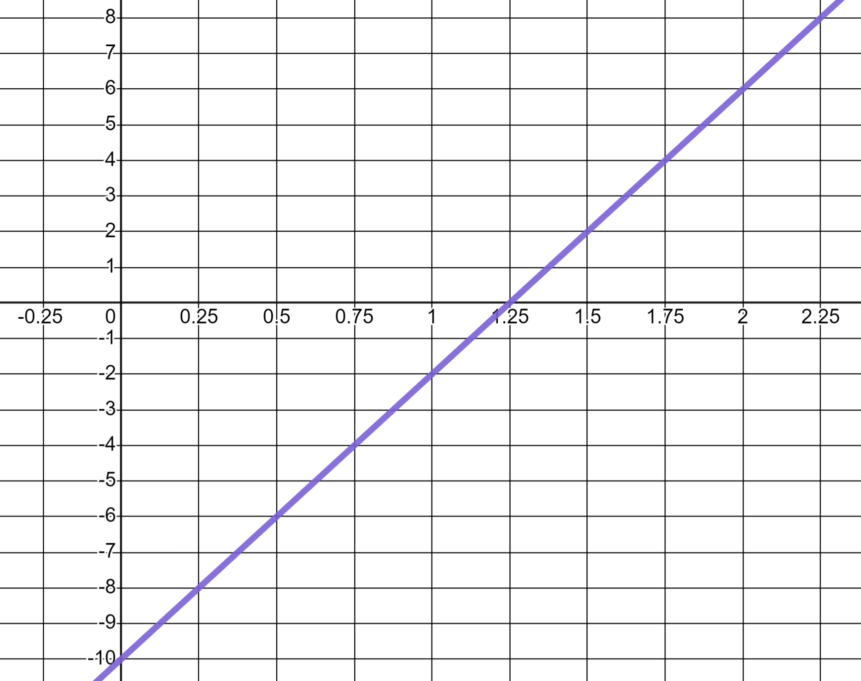
Reading from linear graphs
This is the linear graph y = 8x − 10
We can use it to work out calculations such as 8 × 1.75 − 10
y
✖
(1.75, 4)
From 1.75 on the x-axis we can read 4 on the y-axis.
x
Therefore we know 8 × 1.75 − 10 = 4

Slide 11
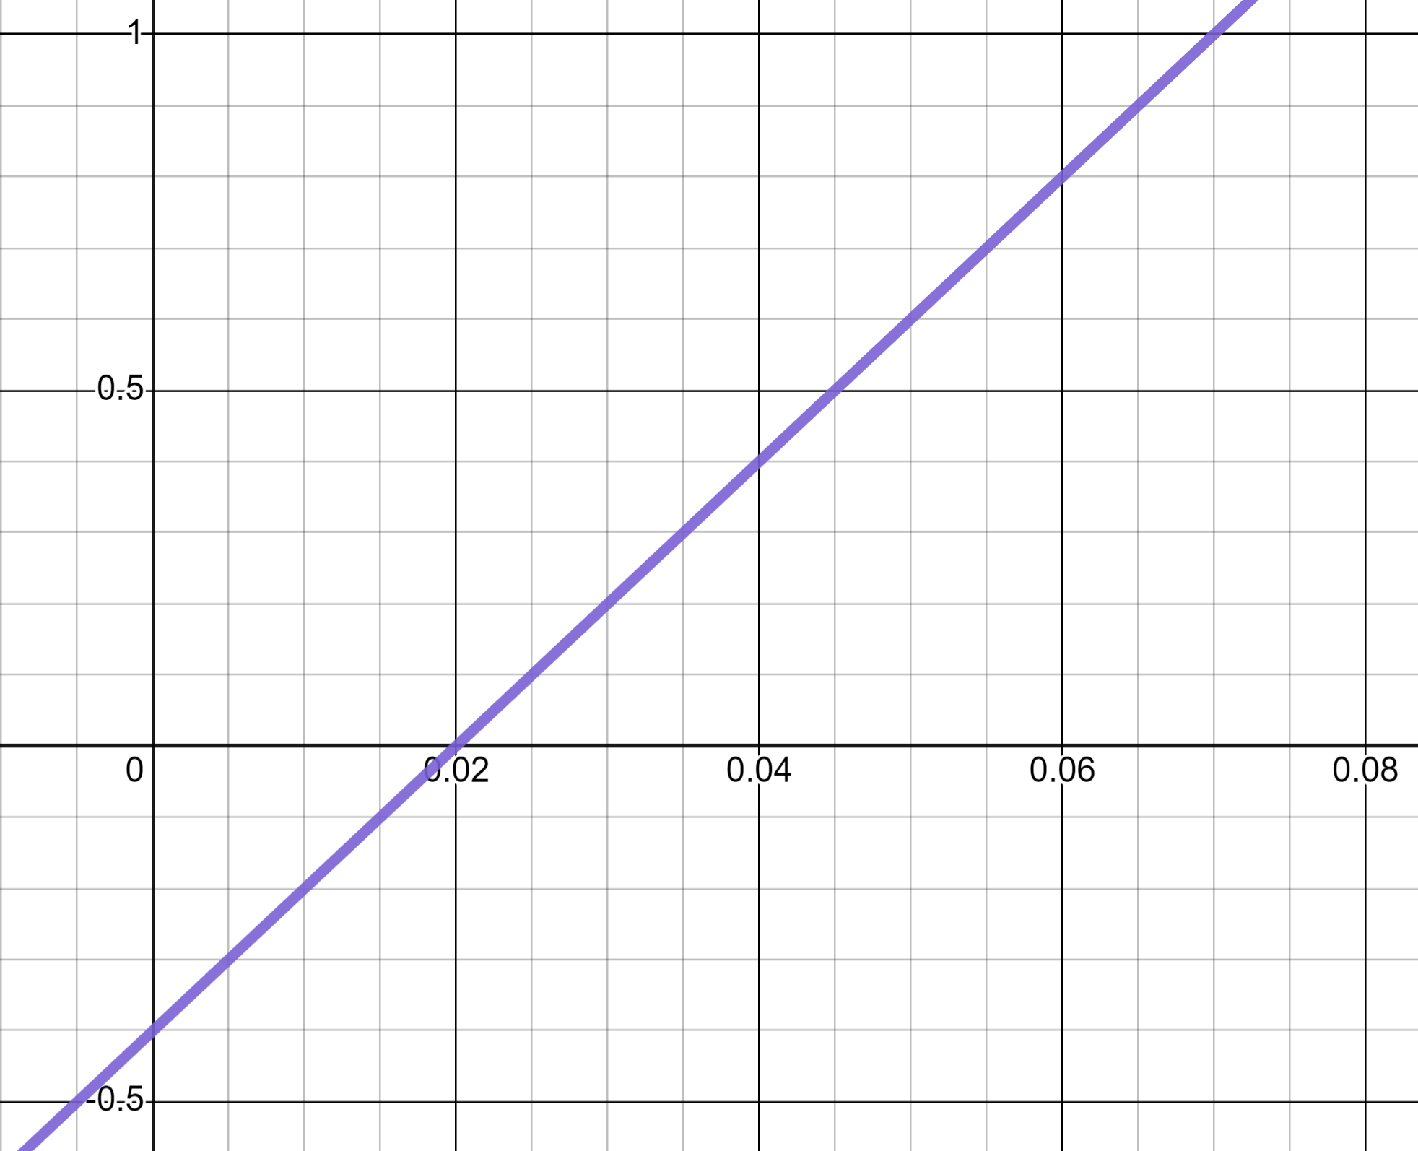
Reading from linear graphs
The linear graph y = 20x − 0.4
y
1
Use it to work out 20 × 0.06 − 0.4
✖
(0.06, 0.8)
From 0.06 on the x-axis we can read 0.8 on the y-axis.
0.5
0
x
Therefore we know 20 × 0.06 − 0.4 = 0.8
−0.5

Slide 12
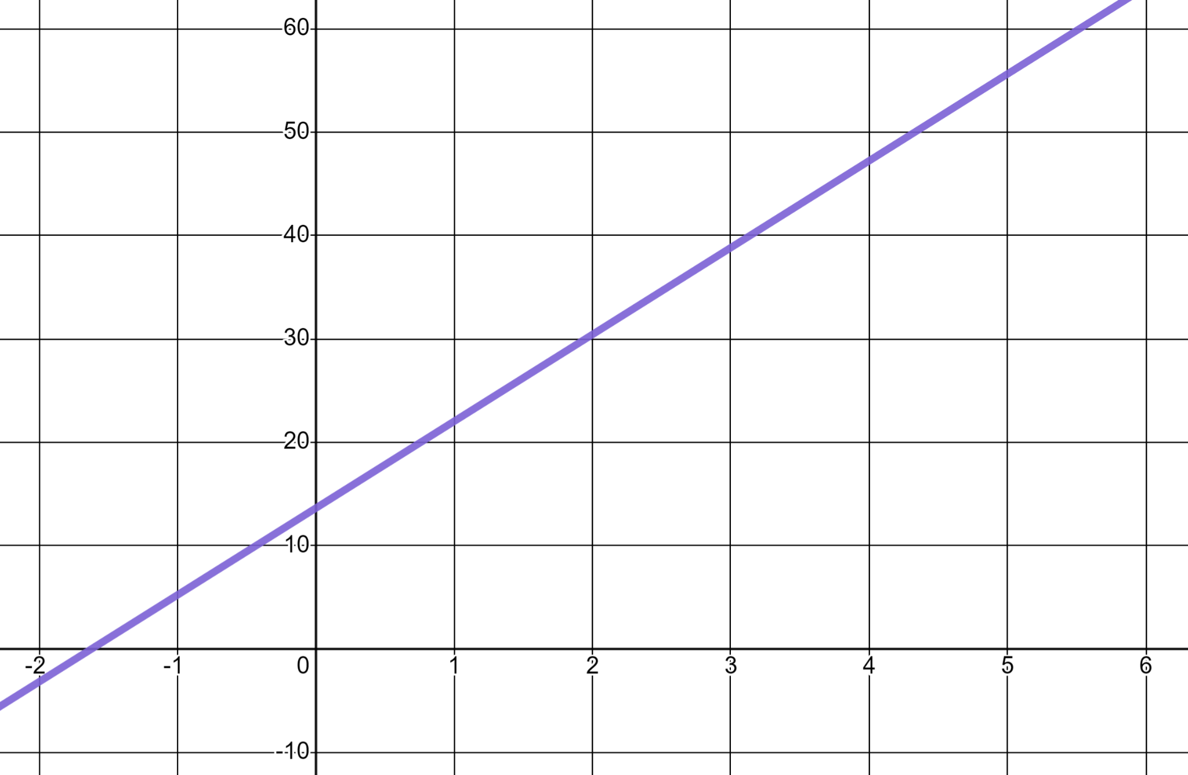
Reading from linear graphs
We can also read estimates from such a graph. This is the linear graph y = 8.4x + 13.65
Estimate:
4 × 8.4 + 13.65
Estimate:
4 × 8.4 + 13.65 ≈ 47
✖
(4, 47)
This is accurate to the nearest whole number.

Slide 13
Reading from linear graphs
Which of these is most likely a good estimate for 3 × 8.4 + 13.65 ?
3 × 8.4 + 13.65 ≈ 39
y = 8.4x + 13.65
≈ 39
✖
(3, 39)
≈ 40
≈ 41

Slide 14
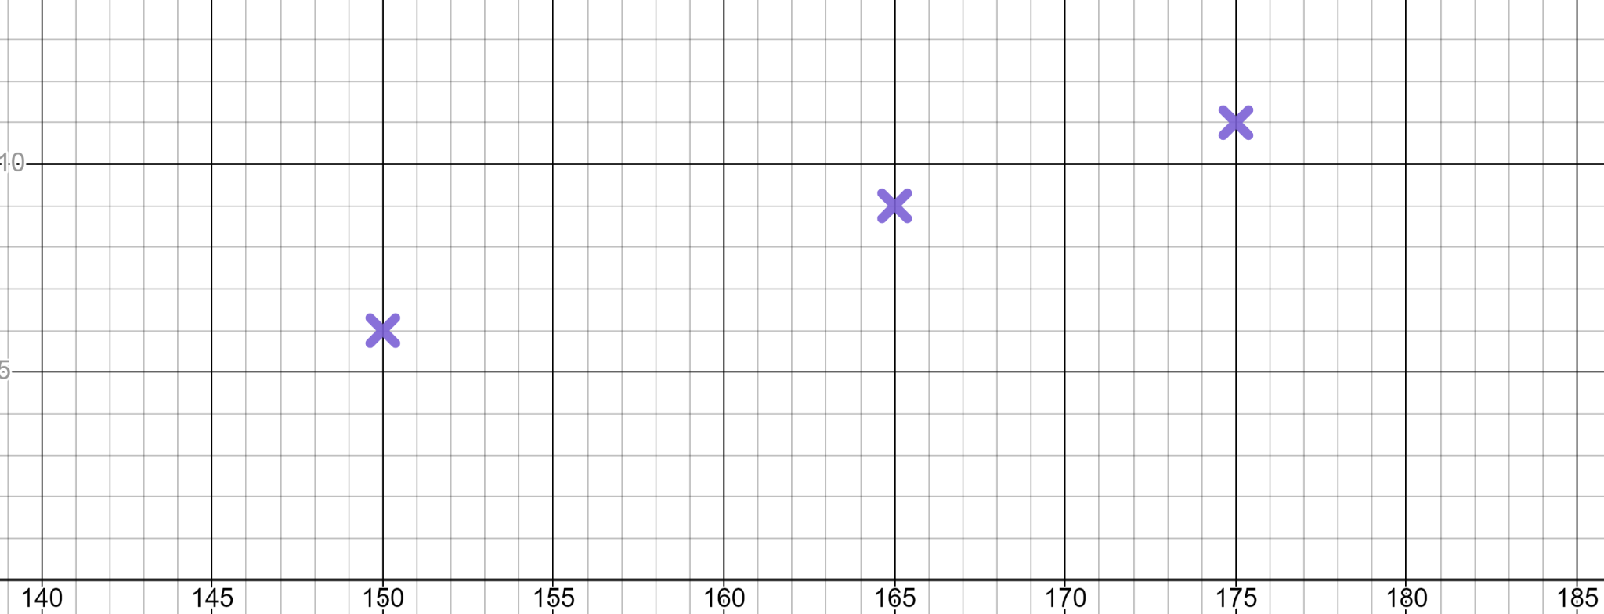



Reading from linear graphs
Reading from graphs can also be used in a practical context.
The Oak pupils measure their height and shoe size
The Oak pupils measure their height and shoe size and find it makes a linear relationship.
Shoe size
10
5
Height (cm)

Slide 15
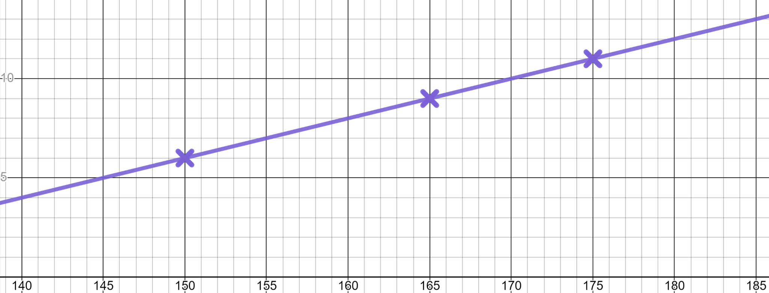
Reading from linear graphs
Modelling a linear relationship like this enables us to make predictions.
From a height of 170 cm we can read a shoe size of 10
From a height of 170 cm
We would expect a pupil of height 170 cm to have a shoe size of 10
Shoe size
10
✖
(170, 10)
5
Height (cm)

Slide 16
Reading from linear graphs
Use the model to predict the height of a pupil with a size 7 shoe.
From a shoe size of 7 we can read a height of 155 cm
We would expect a pupil of shoe size of 7 to have a height 155 cm
Shoe size
10
✖
(155, 7)
5
Height (cm)

Slide 17
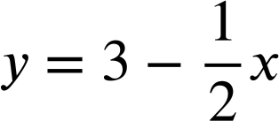
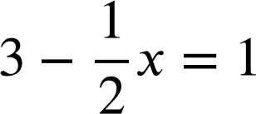
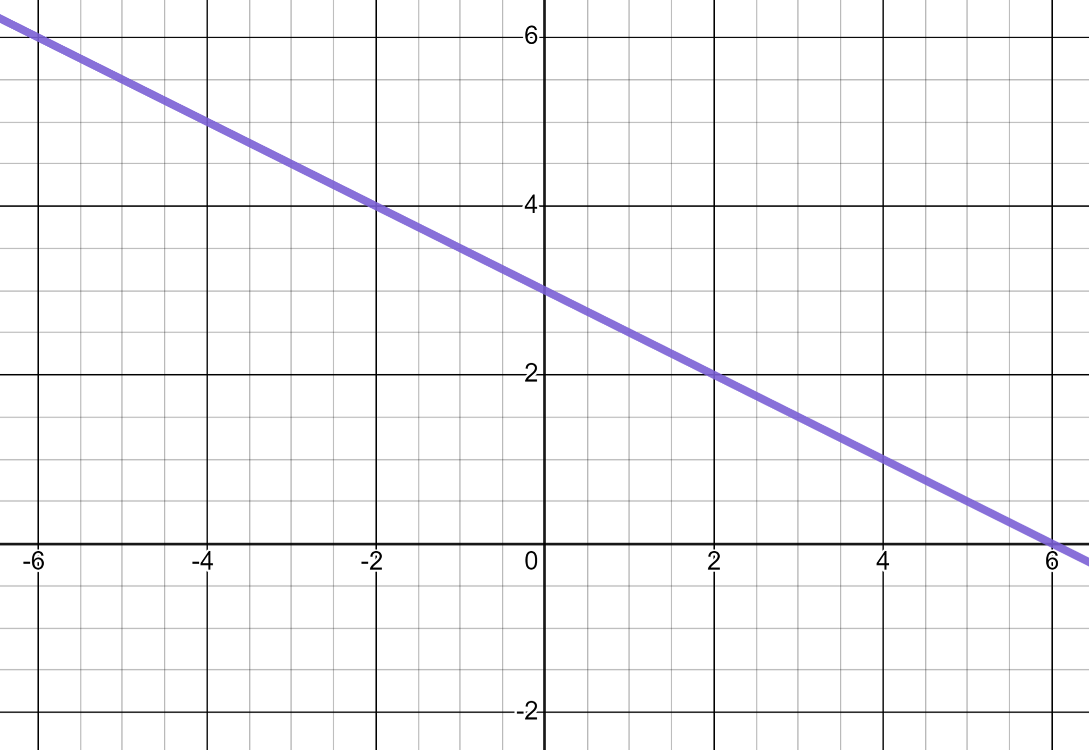
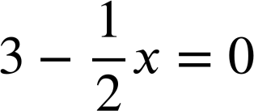
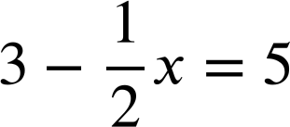
Reading from linear graphs
1) Use this graph of to solve these equations.
a)
y
b)
c)
x

Slide 18
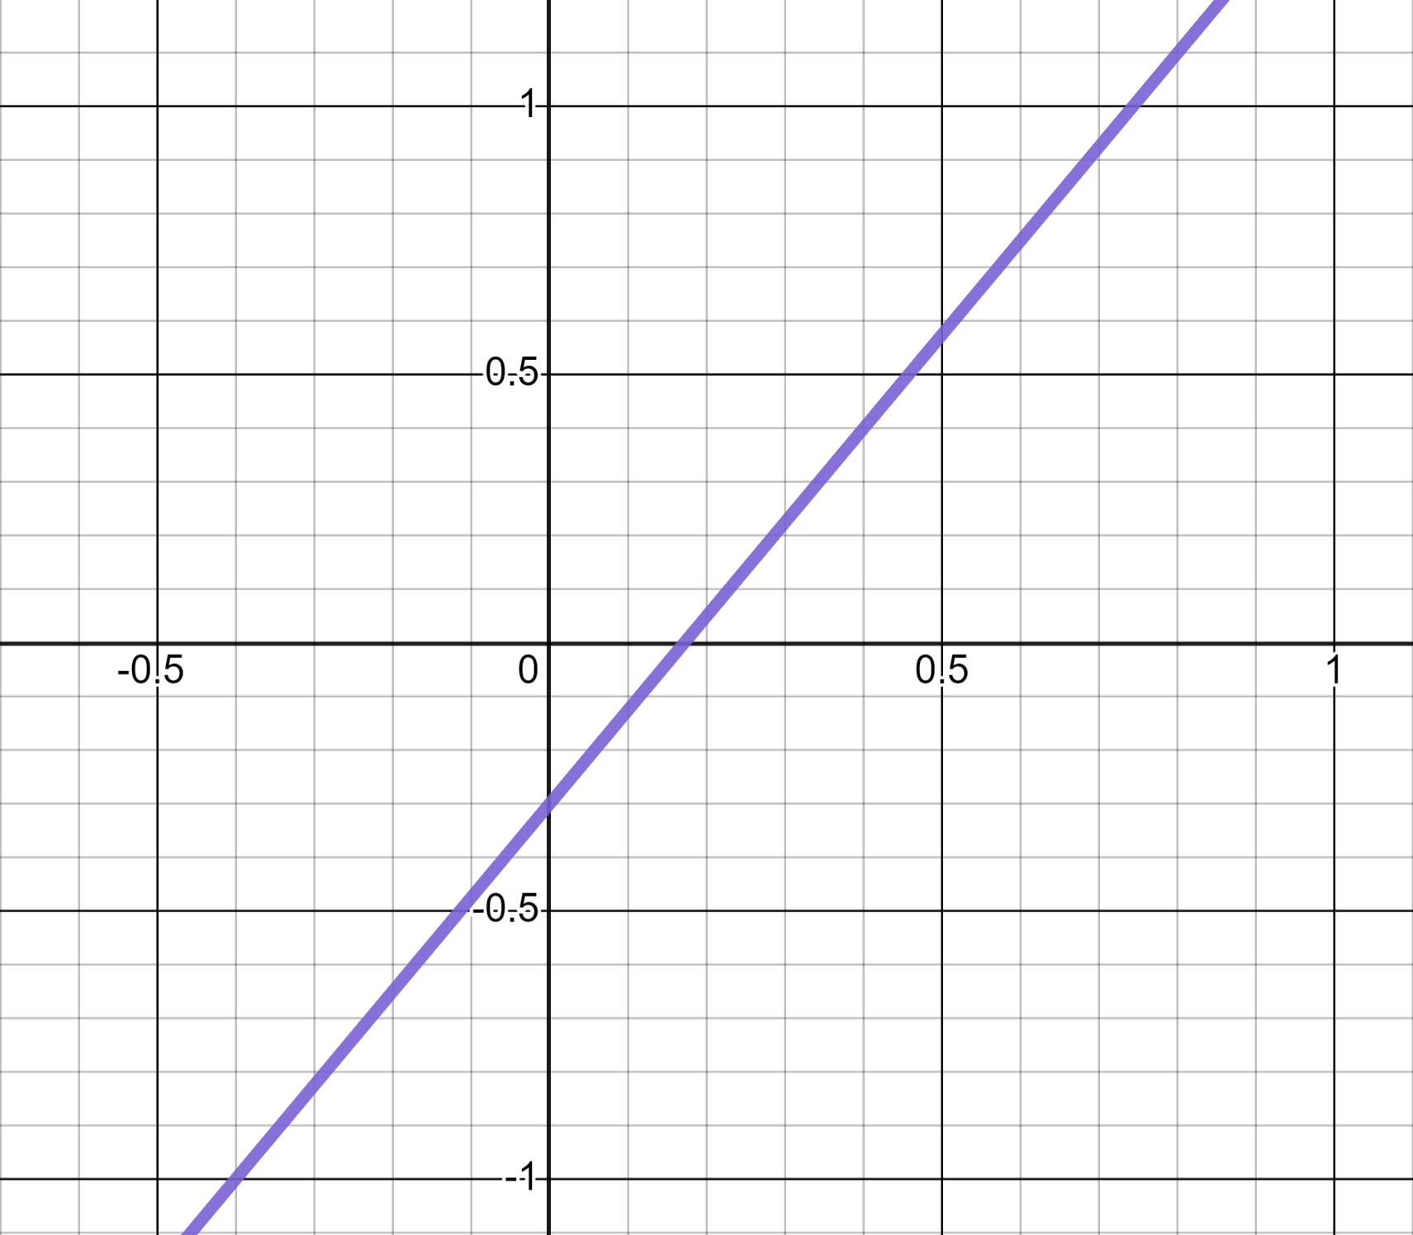
Reading from linear graphs
2) Use this graph of y = 1.75x − 0.3 to calculate:
y
a) 1.75 × 0.8 − 0.3
b) 1.75 × 0.4 − 0.3
x
c) 1.75 × −0.4 − 0.3

Slide 19
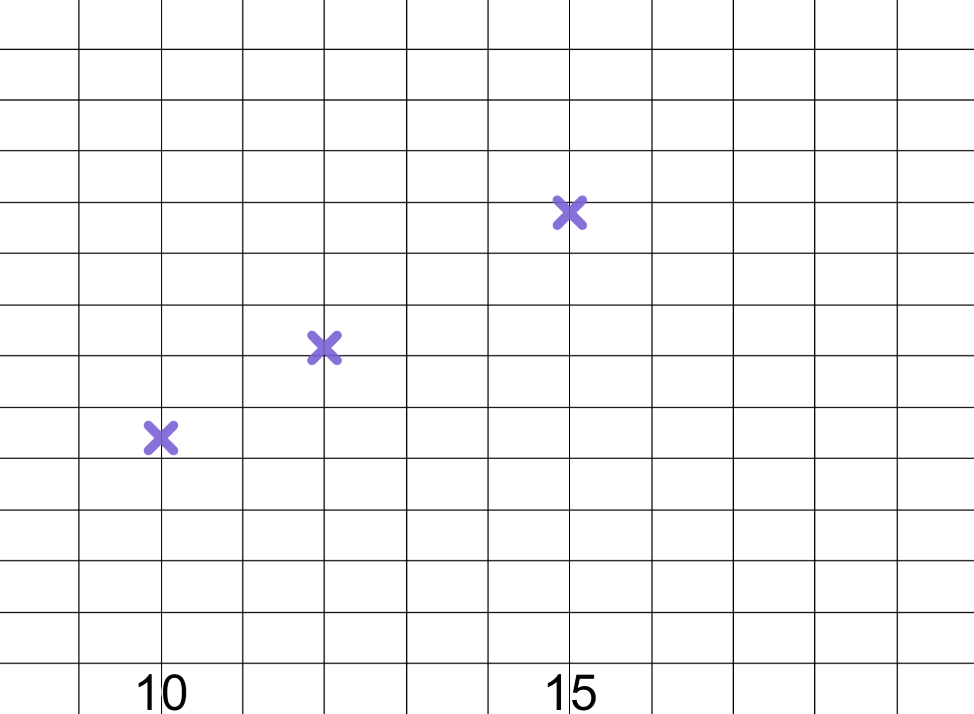
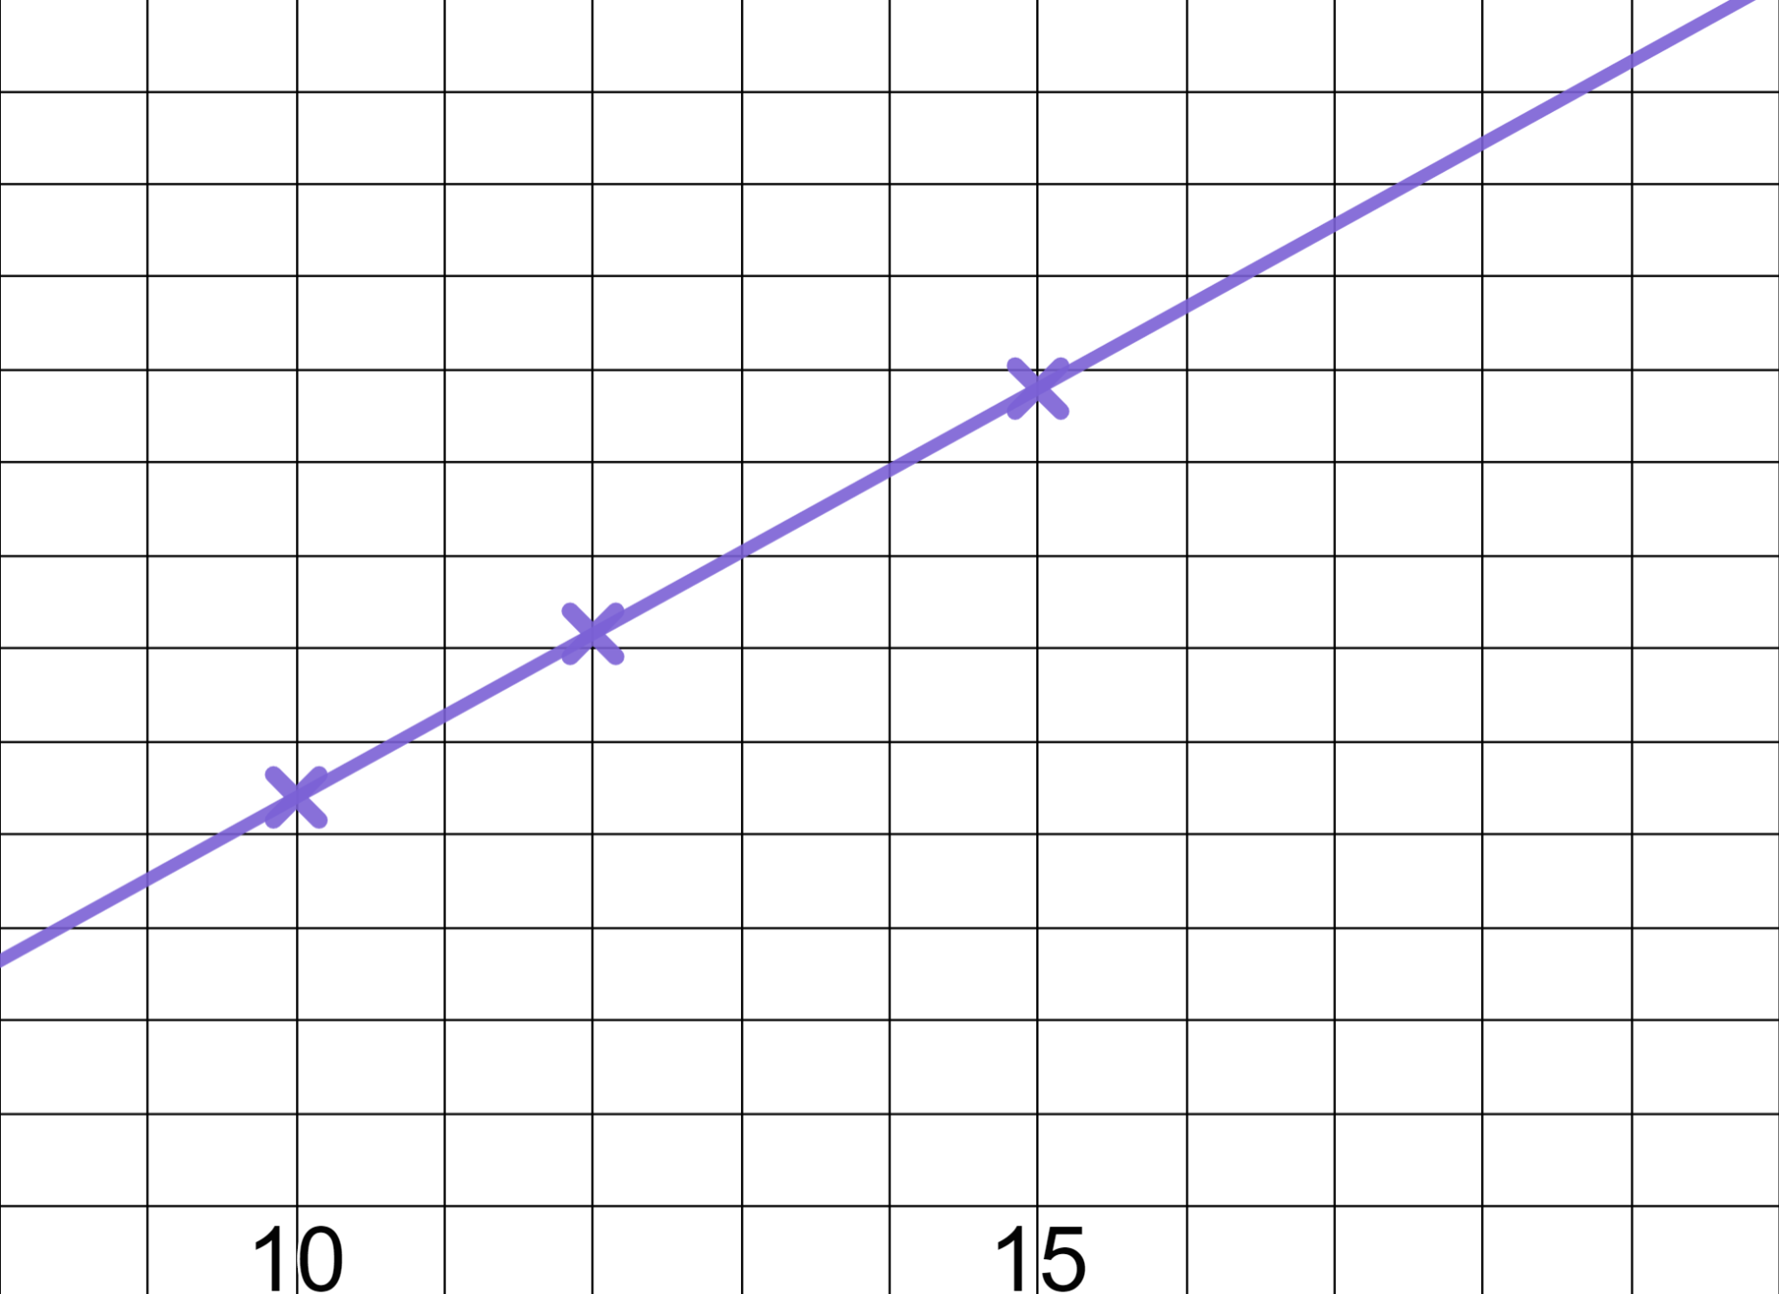
Reading from linear graphs
3) The Oak pupils plot their age against how many books they have read and find a linear relationship.
a) Use the graph to estimate the age of a pupil who has read 400 books.
600
Books read
500
400
b) Use the graph to predict how many books a pupil will have read by the time they reach age 18.
300
200
100
Age (yrs)

Slide 20
Reading from linear graphs
1) Use this graph of to solve these equations.
a)
x = 4
y
b)
(4, 1)
✖
c)
x

Slide 21
Reading from linear graphs
1) Use this graph of to solve these equations.
a)
x = 4
y
b)
x = 6
c)
✖
x
(6, 0)

Slide 22
Reading from linear graphs
1) Use this graph of to solve these equations.
a)
x = 4
y
✖
(−4, 5)
b)
x = 6
c)
x = −4
x

Slide 23
Reading from linear graphs
2) Use this graph of y = 1.75x − 0.3 to calculate:
y
✖
a) 1.75 × 0.8 − 0.3
a) 1.75 × 0.8 − 0.3 = 1.1
(0.8, 1.1)
b) 1.75 × 0.4 − 0.3
x
c) 1.75 × −0.4 − 0.3

Slide 24
Reading from linear graphs
2) Use this graph of y = 1.75x − 0.3 to calculate:
y
a) 1.75 × 0.8 − 0.3
a) 1.75 × 0.8 − 0.3 = 1.1
✖
b) 1.75 × 0.4 − 0.3
b) 1.75 × 0.4 − 0.3 = 0.4
(0.4, 0.4)
x
c) 1.75 × −0.4 − 0.3

Slide 25
Reading from linear graphs
2) Use this graph of y = 1.75x − 0.3 to calculate:
y
a) 1.75 × 0.8 − 0.3
a) 1.75 × 0.8 − 0.3 = 1.1
b) 1.75 × 0.4 − 0.3
b) 1.75 × 0.4 − 0.3 = 0.4
x
c) 1.75 × −0.4 − 0.3
c) 1.75 × −0.4 − 0.3 = −1
(−0.4, −1)
✖

Slide 26
Reading from linear graphs
3) The Oak pupils plot their age against how many books they have read and find a linear relationship.
a) Use the graph to estimate the age of a pupil who has read 400 books.
600
Books read
500
≈ 14
400
✖
(14, 400)
b) Use the graph to predict how many books a pupil will have read by the time they reach 18.
300
200
100
Age (yrs)

Slide 27
Reading from linear graphs
3) The Oak pupils plot their age against how many books they have read and find a linear relationship.
a) Use the graph to estimate the age of a pupil who has read 400 books.
600
✖
Books read
(18, 575)
500
≈ 14
400
b) Use the graph to predict how many books a pupil will have read by the time they reach 18.
300
200
≈ 575
100
Age (yrs)

Slide 28
Reading from graphs
Reading from linear graphs
Reading from quadratic graphs

Slide 29
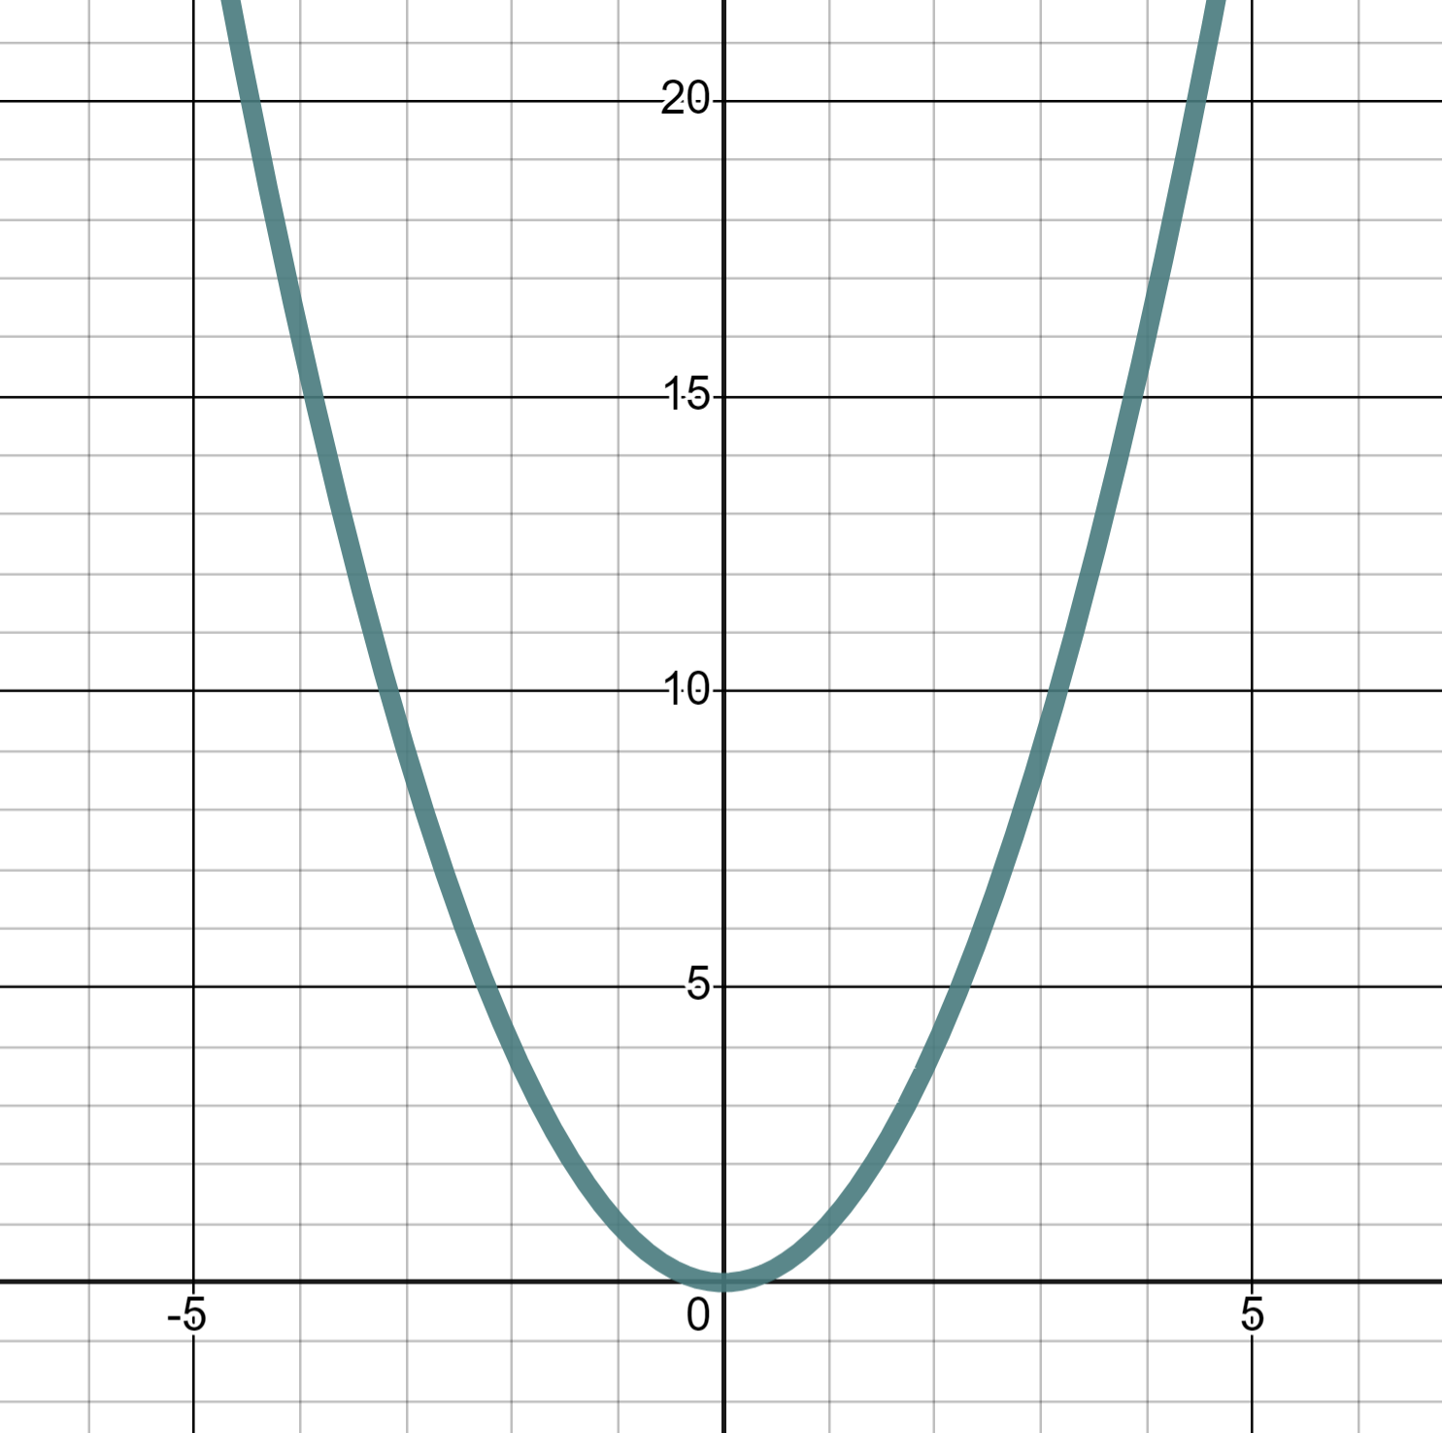
Reading from quadratic graphs
It’s not just linear graphs that we can read from.
This is the graph of the quadratic equation y = x²
y
We can read the coordinate (4, 16)
✖
(4, 16)
This means that the values x = 4, y = 16 satisfy the equation.
y = x²
(16) = (4)²
x

Slide 30
Reading from quadratic graphs
Because quadratic graphs form the shape of a parabola we can sometimes take two readings.
y = x²
y
There are two moments when y = x² has a y-value of 16
✖
✖
✖
(−4, 16)
(4, 16)
(4, 16)
Therefore, there are two solutions to x² = 16
They are x = 4 and x = −4
x

Slide 31
Reading from quadratic graphs
Find the two moments when x² = 9
y
x² = 9 when x = 3 and x = −3
(−3, 9)
✖
✖
(3, 9)
x

Slide 32
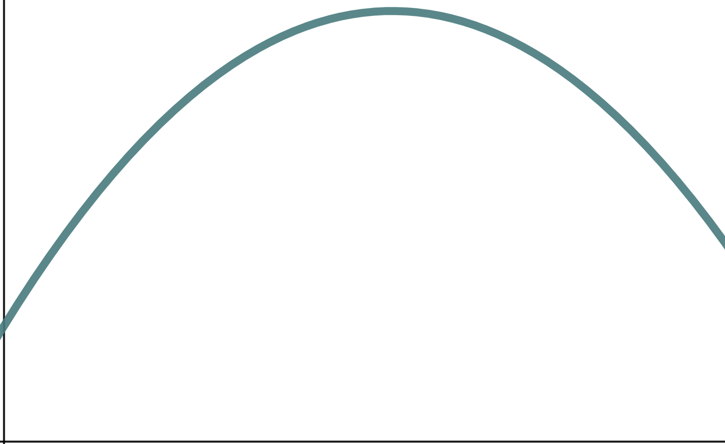
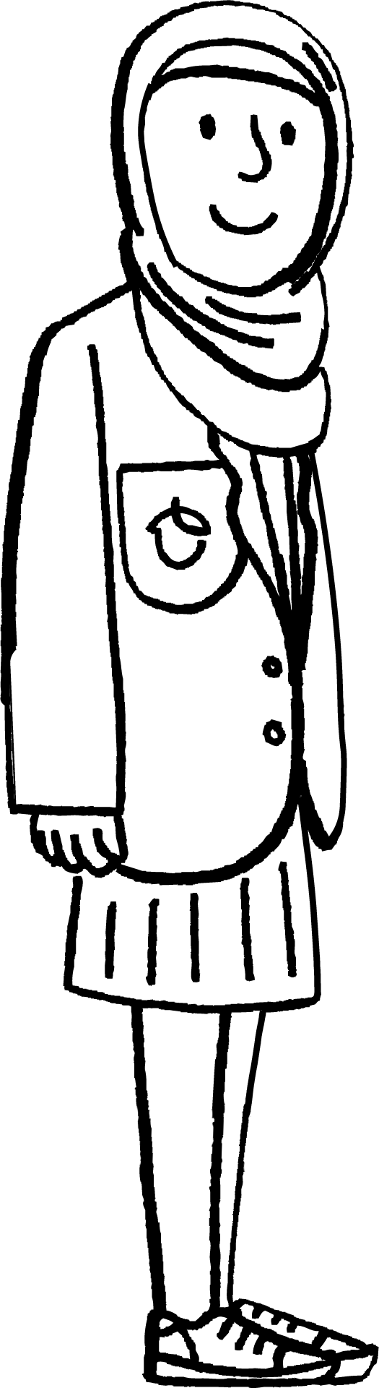
Reading from quadratic graphs
Parabolas are really useful for modelling real-life situations.
Aisha is playing Basketball and notices the path of the ball follows that of a parabola.
Height
Distance

Slide 33
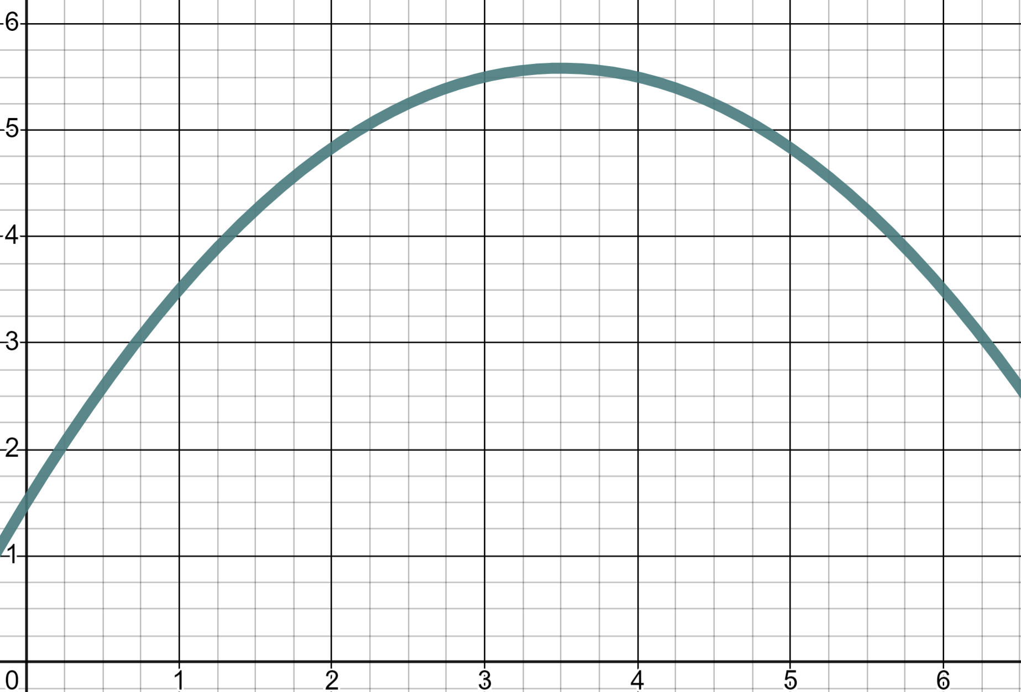
Reading from quadratic graphs
Parabolas are really useful for modelling real-life situations.
When is the ball 5 metres above the ground?
6
Height (m)
5
4
3
2
Distance (m)
1
2
3
4
5
6

Slide 34
Reading from quadratic graphs
Parabolas are really useful for modelling real-life situations.
When is the ball 5 metres above the ground?
6
(2.25, 5)
(4.8, 5)
Height (m)
✖
✖
5
✖
4
After 2.25 and 4.8 m
3
There are two moments when the ball is 5 metres above the ground.
2
Distance (m)
1
2
3
4
5
6

Slide 35
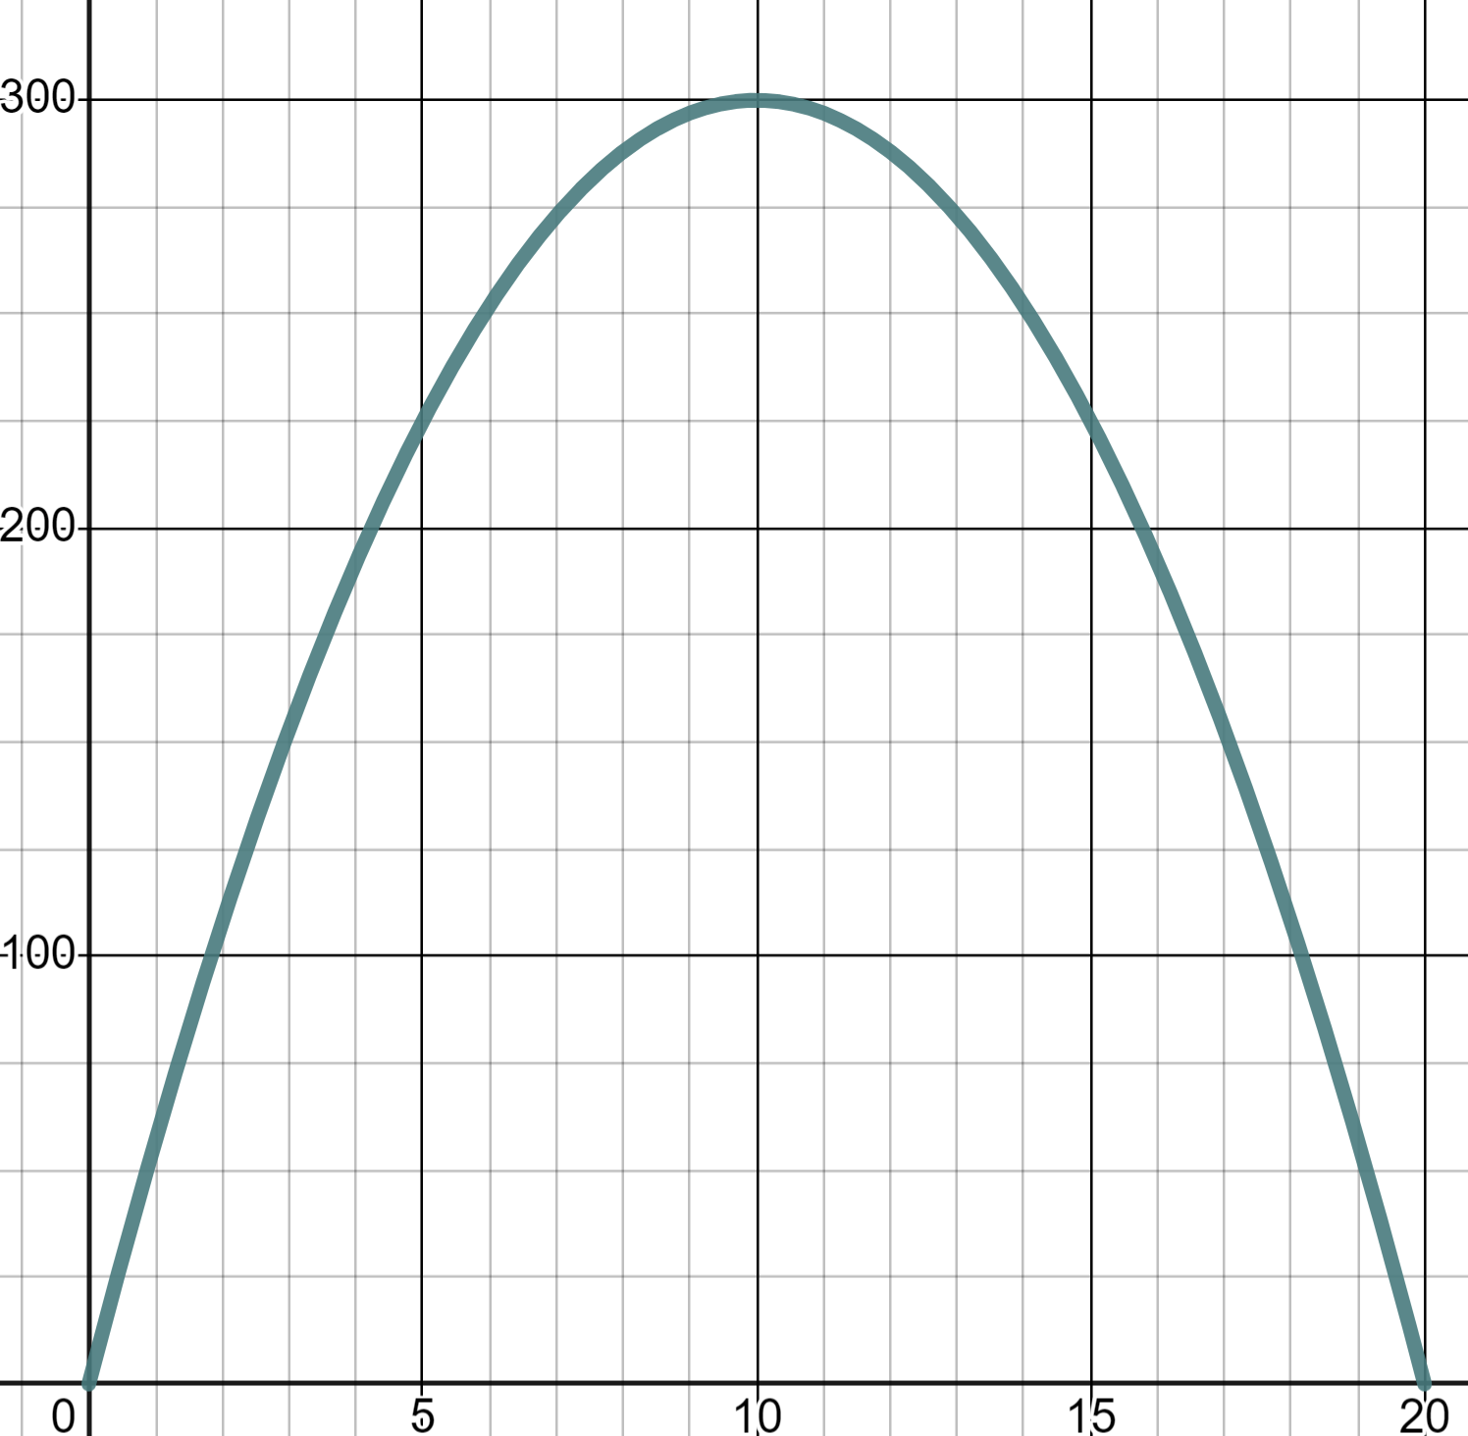
Reading from quadratic graphs
This parabola models the flight of a toy glider. What height is the glider at after 3 seconds?
300
225 m
Height (m)
200
150 m
One value when reading up from the horizontal axis.
✖
(3, 150)
100
300 m
Second (s)
0
5
10
15
20

Slide 36
Reading from quadratic graphs
This parabola models the flight of a toy glider. At what time is the glider at 225 m ?
300
5 s
Height (m)
(5, 225)
(15, 225)
✖
✖
6 s
200
13 s
100
Two values when reading across from the vertical axis.
15 s
Second (s)
0
5
10
15
20

Slide 37
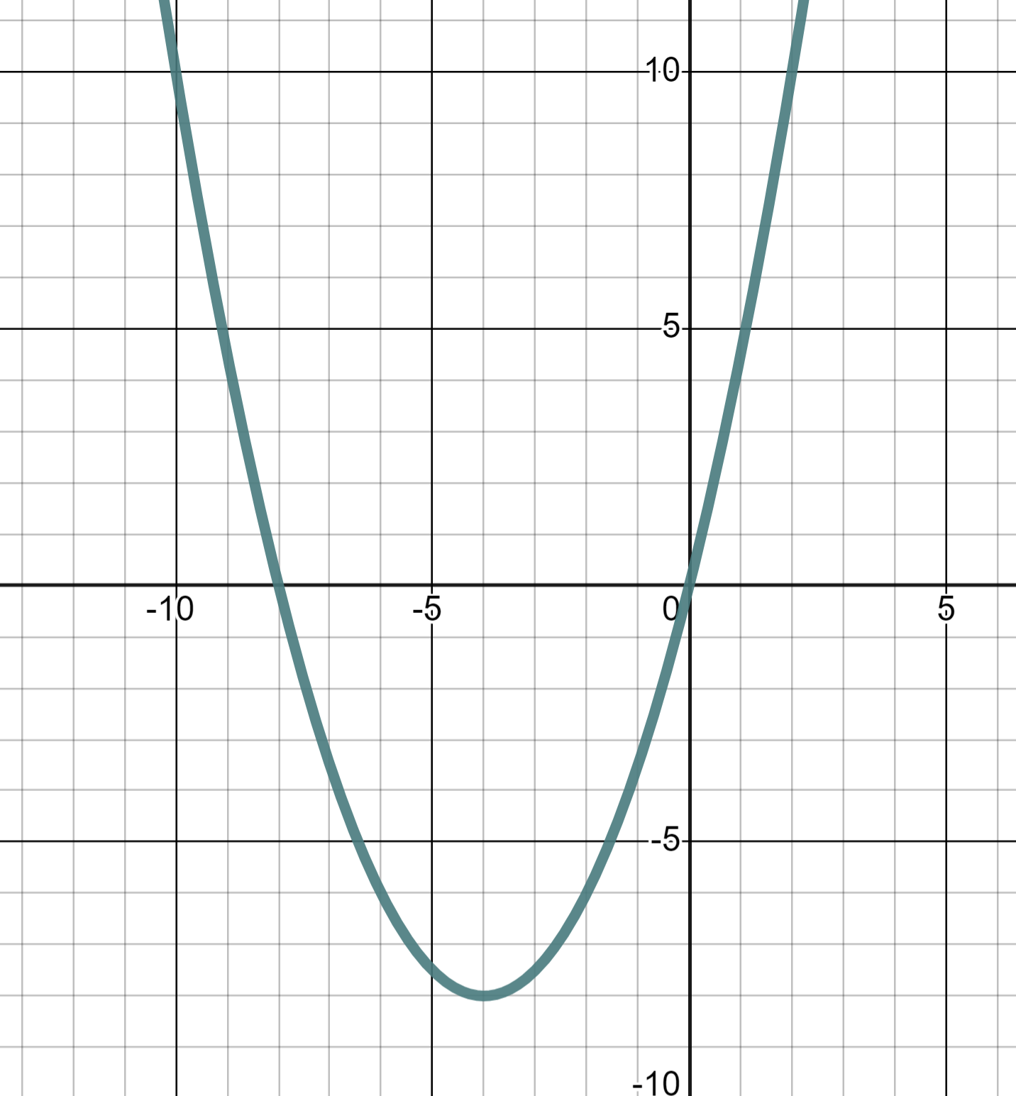
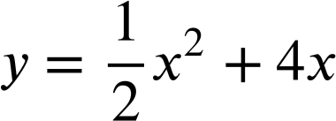
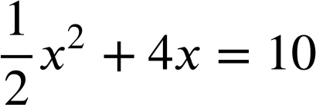
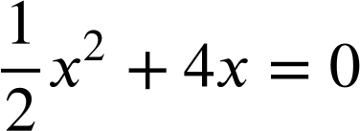
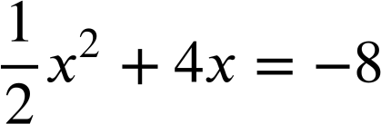
Reading from quadratic graphs
1) This is the graph of the quadratic equation
y
Use the graph to solve:
a)
x
b)
c)

Slide 38
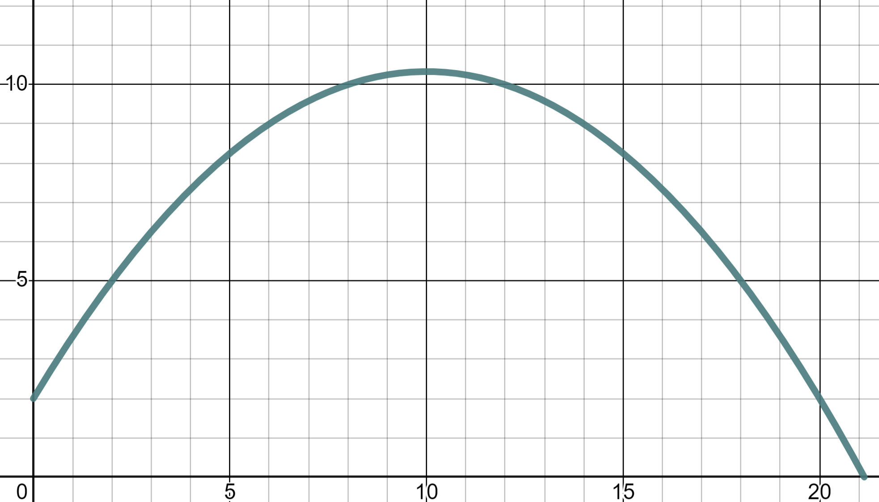
Reading from quadratic graphs
2) This parabola models the flight of a cricket ball being thrown.
Use the graph to read:
10
a) The height of the ball at a distance 18 metres.
Height (m)
b) The distance when the ball is at a height of 9 metres.
5
c) The distance when the ball is at a height of 12 metres.
0
5
10
15
20
Distance (m)

Slide 39
Reading from quadratic graphs
1) This is the graph of the quadratic equation
(−10, 10)
y
(2, 10)
✖
✖
Use the graph to solve:
x = −10 and x = 2
a)
x
b)
c)

Slide 40
Reading from quadratic graphs
1) This is the graph of the quadratic equation
y
Use the graph to solve:
x = −10 and x = 2
a)
✖
✖
x
(−8, 0)
(0, 0)
x = −8 and x = 0
b)
c)

Slide 41
Reading from quadratic graphs
1) This is the graph of the quadratic equation
y
Use the graph to solve:
x = −10 and x = 2
a)
x
x = −8 and x = 0
b)
c)
x = −4 one value only
✖
(−4,−8)

Slide 42
Reading from quadratic graphs
2) This parabola models the flight of a cricket ball being thrown.
Use the graph to read:
10
a) The height of the ball at a distance 18 metres.
Height (m)
Height = 5 m
b) The distance when the ball is at a height of 9 metres.
5
✖
(18, 5)
c) The distance when the ball is at a height of 12 metres.
0
5
10
15
20
Distance (m)

Slide 43
Reading from quadratic graphs
2) This parabola models the flight of a cricket ball being thrown.
Use the graph to read:
10
(6, 9)
(14, 9)
a) The height of the ball at a distance 18 metres.
Height (m)
✖
✖
Height = 5 m
b) The distance when the ball is at a height of 9 metres.
5
Distance = 6 m and 14 m
c) The distance when the ball is at a height of 12 metres.
0
5
10
15
20
distance (m)
The ball never reaches a height of 12 m

Slide 44
Reading from graphs
We can read and interpret points from a graph to solve problems. That could be to solve an equation, or to solve a real-world problem in context. The graph we read from may be linear, but not always. For example, we might read from quadratic graphs to solve problems.

Slide 45

© Oak National Academy 2024.
Produced in partnership with Mathematics in Education and Industry.
Licensed on the Open Government Licence v3.0, except where otherwise stated. See Oak terms and conditions.

